Slide 1

Applied Data Science
Project
Team 2:
Jia Ying, Fariz, Hassan, Wee Kiat

Slide 2
Couples in Singapore require insights into the every increasing cost of HDB resale prices in Singapore.
Business Goal :
Empowering married couples with predictive insights into HDB resale prices to best prepare them in decision-making and strategic planning.

Slide 3
Objective 1: Forecasting Model - Jiaying:
Objective: Develop a time-series forecasting model to predict future HDB resale prices based on historical data from 1990 to 2000.
Goal: Enable accurate prediction of future resale prices, allowing stakeholders to anticipate market trends and make informed investment and policy decisions.
KPI: Achieve high predictive accuracy with a margin of error within ±5% of actual future prices.
Objective 2: Regression Model - Fariz: Objective: Build a regression model to quantify the relationship between HDB resale prices and various influencing factors such as location, size, age, and economic indicators.
Goal: Provide precise estimates of how each factor impacts resale prices to help stakeholders understand price determinants.
KPI: Achieve high model interpretability and statistical significance of key factors, with a high R-squared value indicating good fit.
Objective 6: Recommendation System - Hassan: Objective: Create a recommendation system that suggests optimal buying or selling times and the best neighborhoods for investment based on historical price trends and individual preferences.
Goal: Provide personalized recommendations to potential buyers and sellers to maximize investment returns.
KPI: Measure user satisfaction and recommendation relevance, ensuring recommendations align with market movements.
Objective 7: Natural Language Processing (NLP) Model: (Wee Kiat)
Objective: Use an NLP model to analyze textual data such as property descriptions, advertisements, and buyer reviews from the 1990 to 2000 period.
Goal: Extract valuable insights on features and amenities that were most appealing to buyers, informing future property development and marketing strategies.
KPI: Extract key themes and sentiment from textual data with high accuracy, providing actionable insights into buyer preferences.
Objectives
Forecasting: Jia ying
Classification: Fariz
Recommendation: Hassan
Text Analysis: Wee Kiat
Develop a time-series forecasting model to predict HDB resale prices until 2030, utilizing historical data from 1990 to 2020. This model aims to provide married couples with actionable insights for informed decision-making and strategic planning in their property investments.
Classify HDB flats into three price ranges from low, medium and high. This helps couples understand the affordability of various options.
Create a recommendation system that suggests hdb flats based on user requirements
Use an NLP model to classify the people review to the type of housing experience in Singapore.
Notes:
Sentiment analysis typically involves these steps:
Text Preprocessing: Cleaning the text by removing noise like punctuation, stop words, and irrelevant information.
Feature Extraction: Identifying key words or phrases that indicate sentiment.
Sentiment Classification: Assigning a sentiment label (positive, negative, neutral) to the text based on the extracted features.
NLTK (Natural Language Toolkit): A Python library with sentiment analysis capabilities.
TextBlob: A Python library for processing textual data.
VADER (Valence Aware Dictionary and Sentiment Reasoner): A sentiment analysis tool specifically attuned to social media text.

Slide 4
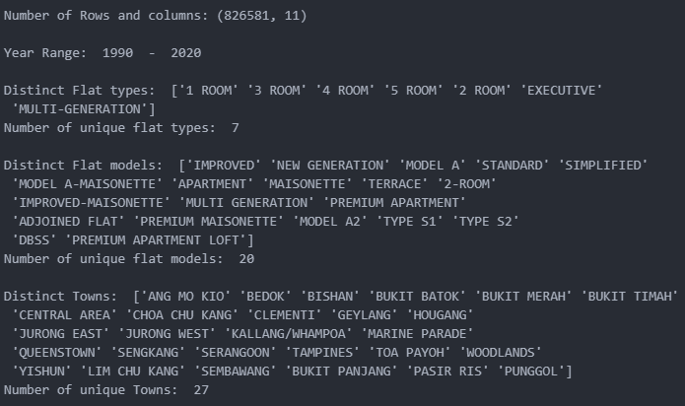
Dataset Data Collection and Exploration part 1:
https://www.kaggle.com/datasets/teyang/singapore-hdb-flat-resale-prices-19902020. : 5 csv files
In the country of Singapore, where the land space is scarce. Ever growing concern from the population especially newly married couple in purchasing housing. Therefore to have a better grasp on the resale prices of HDB in Singapore.
826,581
ROWS
11
COLUMNS
1990- 2020
YEAR
7 distinct Flat Types
20 distinct Flat Models
27 distinct Towns

Slide 5
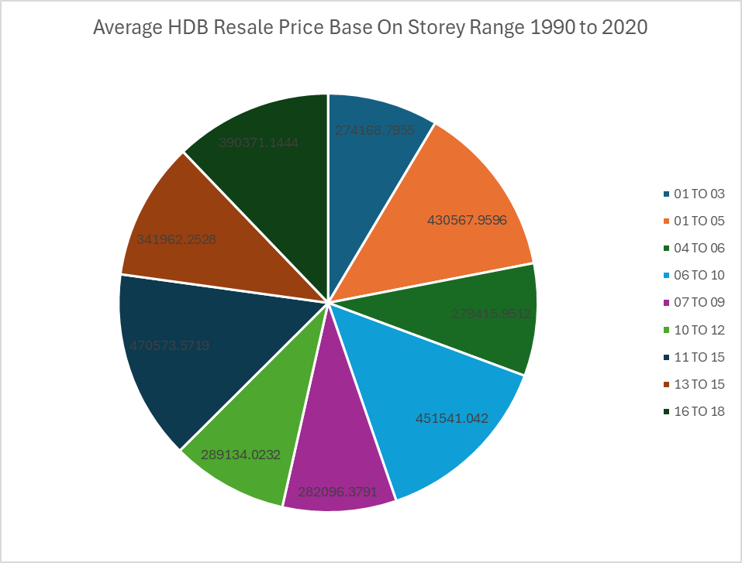
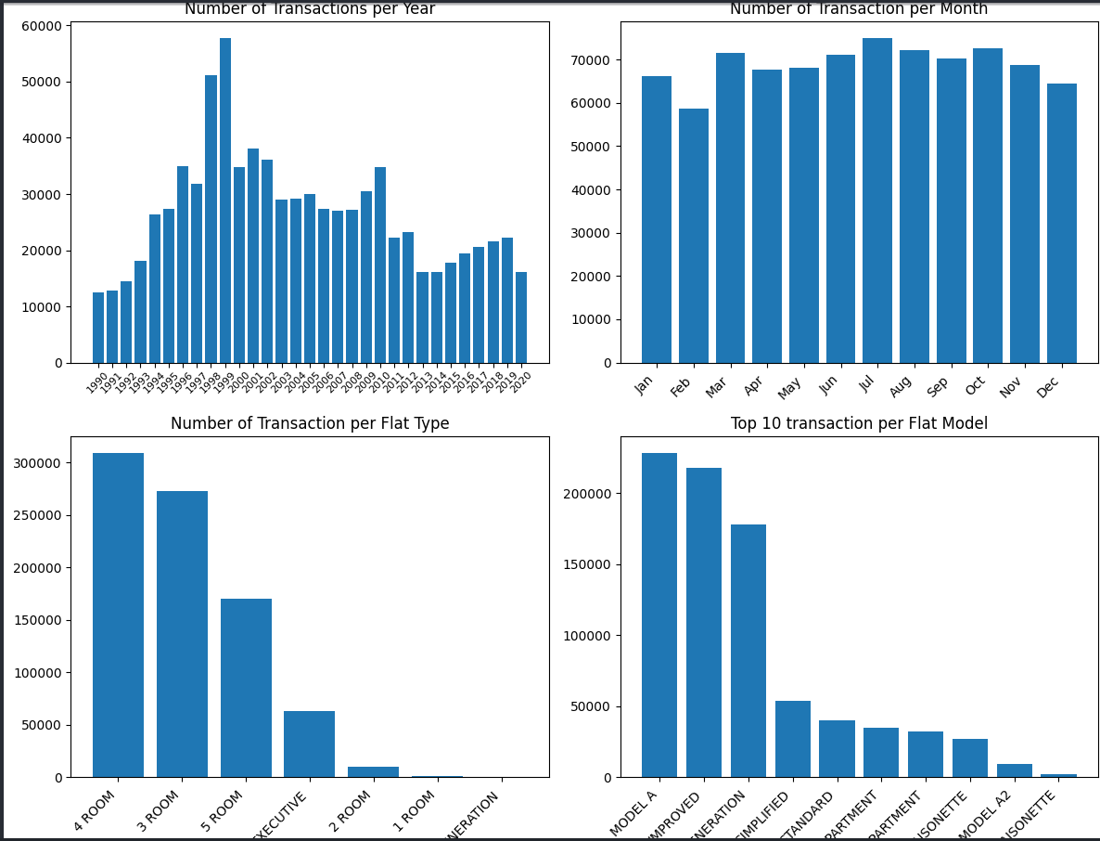
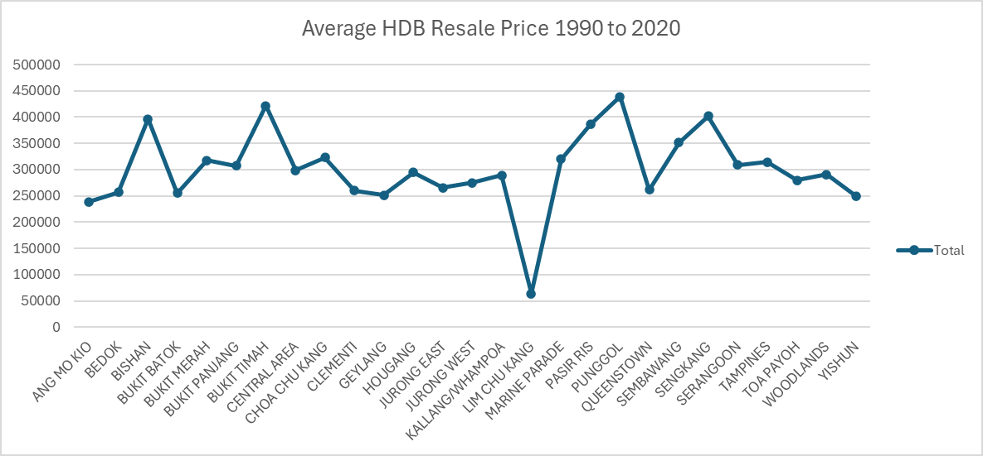
Dataset Data Collection and Exploration part 2:
https://www.kaggle.com/datasets/teyang/singapore-hdb-flat-resale-prices-19902020. 4 csvs

Slide 6
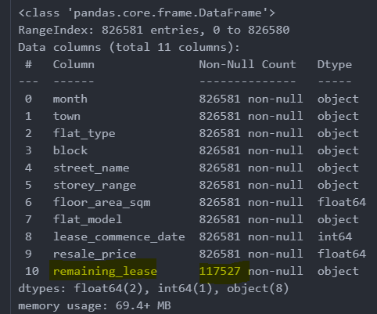
Data Transformation - Hassan:
Splitting
Splitting month column into transaction_year and transaction_month
Created a new columns by splitting on the ‘hyphen’, the dropped the old month column
Removing Null Values: ‘Remaining_lease’ column
Assumption that HDB lease is up to 99 years. Created a new column new_remaining_lease based on the formula; 99 years - (transaction_year - lease_commence_date)
Null Values
Data Check
In flat_type column (2-room, 2-ROOM) , and in flat_model (MULTI GENERATION','MULTI-GENERATION')
Standardising the data set, for flat_type column change to MULTI-GENERATION, for flat_model make everything uppercase

Slide 7
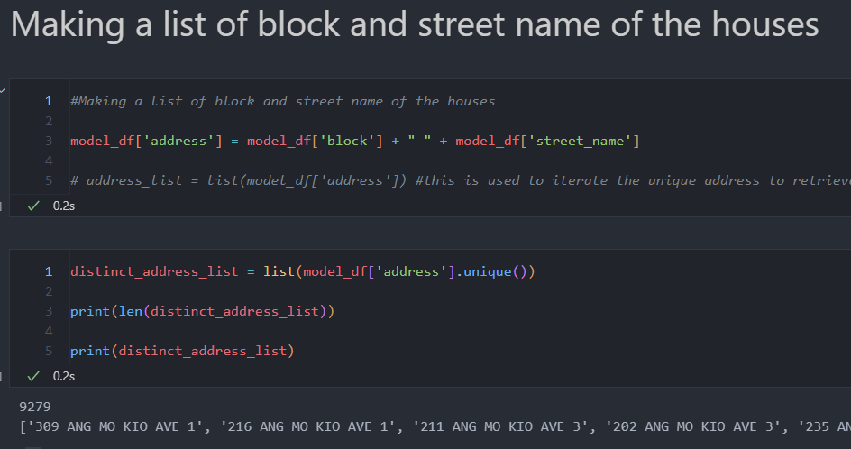
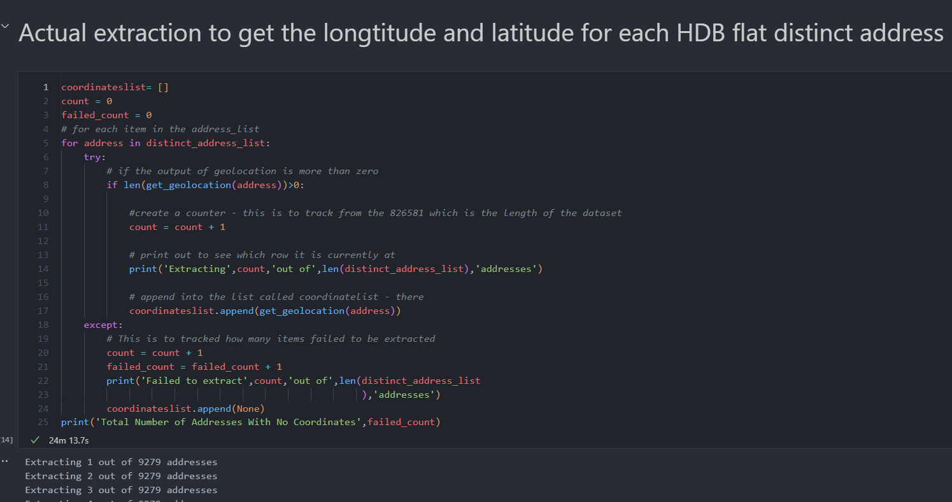
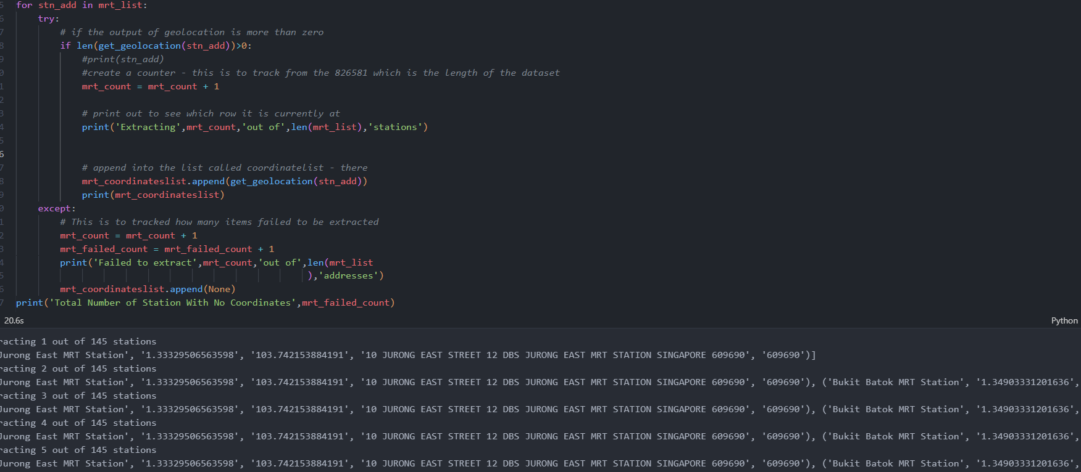
Data Transformation pt 2 - Hassan:
Combine block and street name to a field ‘address’
Create Address
Extracting lat and lon
Use OneMap API to get longitude and latitude, using unique addresses to speed up processing time and store in geolocation_df
Extract mrt lat and lon
Created a csv of mrt station from website
Then use OneMap API to get the station lat and lon
website reference of station list: https://mrtmapsingapore.com/mrt-stations-singapore/

Slide 8
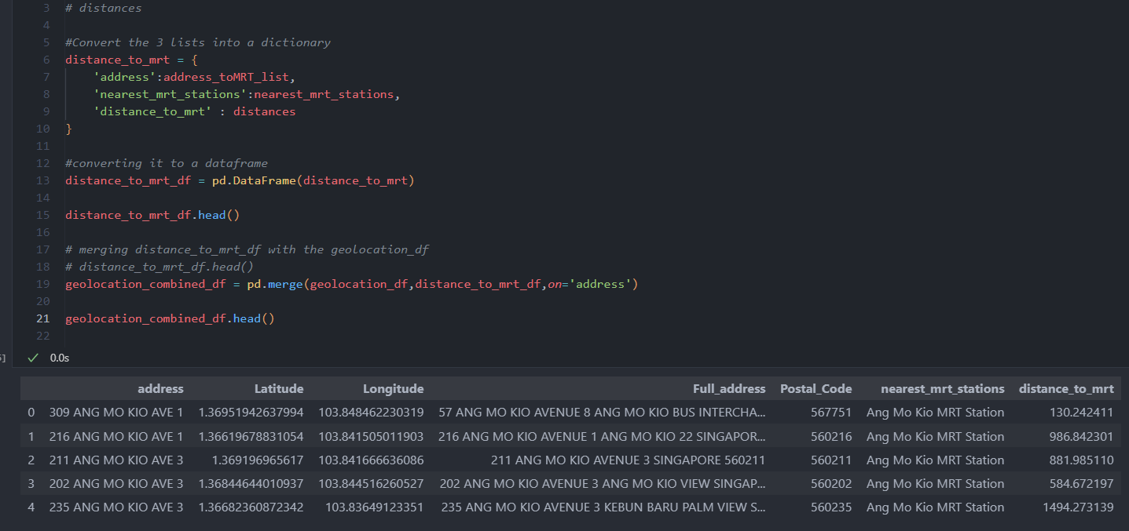
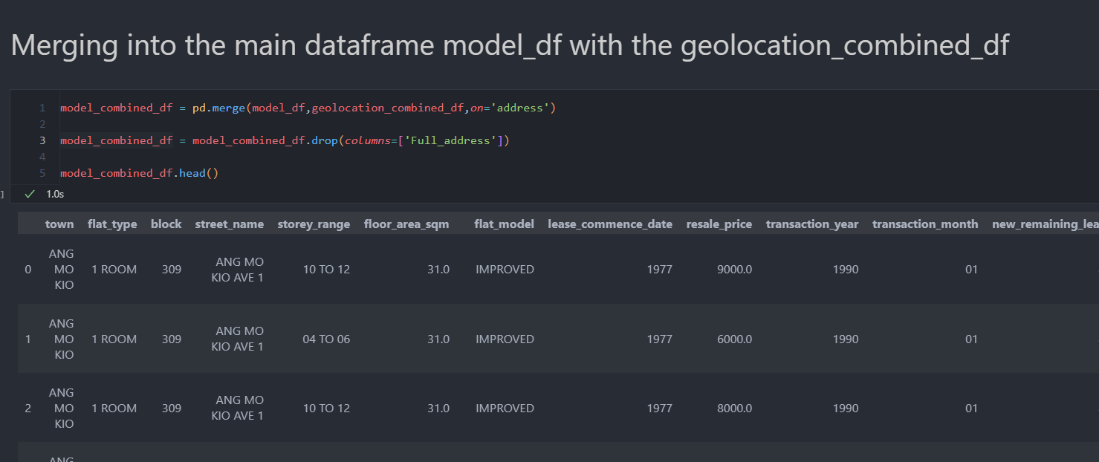
Data Transformation pt 3 - Hassan:
Calc dist to nearest mrt
Calculating distance to nearest mrt from hdb
Using the lat and long of both HDB and mrt station is able to calculate the distance
Merge back to main df
Merge the dataset back to main dataframe and discard unnecessary columns
Slice data 2017-2020
Due to memory and storage limitation and also as we require the most recent dataset, I decide to slice the dataset to > 2017

Slide 9
Data Modelling : Collaborative Filtering vs Association Rule Mining
Initial thoughts was to do a collaborative filtering based on User purchase using cosine sim.The issue is there is no User profile in the dataset.So I initially created a random dataset of unique user id to speculate their transactions, but the output of the cosine similarity was odd and unsatisfying.
Association rule:
Association rule mining is a technique used in data mining to discover interesting relations (or associations) between variables in large datasets.
I will be using this model to find association between the different variables, and using Streamlit to allow users to select the recommend fields
Key terms:
Antecedent: (If) The condition or set of items/features (e.g., {town=ANG MO KIO, flat_type=4 ROOM}) that must be met for the rule to be considered.
Consequent: (Then) The outcome or associated items/features that follow the antecedent (e.g., {price_category=High}).
Support: The proportion of transactions in the dataset where the rule is true. It indicates how frequently the items in both antecedent and consequent appear together in the dataset.Example: If 25% of the dataset transactions contain the combination of {town=ANG MO KIO, flat_type=4 ROOM} leading to {price_category=High}, the support is 0.25.
Confidence: The likelihood that the consequent is true given that the antecedent is true. It measures how often items in the consequent appear in transactions that contain the antecedent. Example: If 80% of the transactions that include {town=ANG MO KIO, flat_type=4 ROOM} also include {price_category=High}, the confidence is 0.8.
Lift: The ratio of the observed support to that expected if the antecedent and consequent were independent. A lift greater than 1 indicates a positive correlation between the antecedent and consequent. Example: A lift of 1.2 means that {price_category=High} is 1.2 times more likely to occur with the antecedent than by random chance.

Slide 10
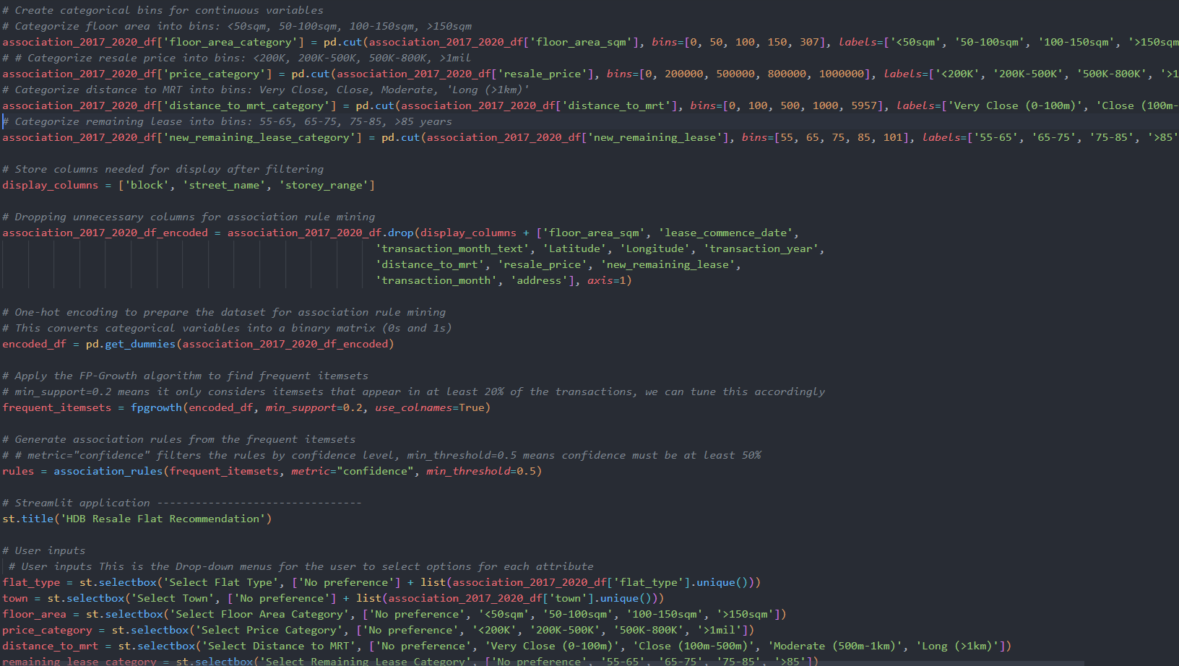
Data Modelling : Association Rule Mining - FP-Growth (Frequent Pattern Growth)
The reason i selected FP-Growth VS Apriori (which i also tested) is that as the dataset is huge and my PC was limited I found out that FP-Growth is recommended as one of the advantages is that FP-Growth is more efficient especially for large datasets, and reduces the need to scan the dataset multiple times.
This model is then fed to a streamlit app where users can select certain fields they preferred in their HDB like Flat type or nearest to mrt station and this model will be fed to the Streamlit app.
Here we are using the FP Growth algorithm to find the most frequent itemsets, based on the predefined that means minimum_support must be 20% and confidence min threshold must be at least 50%.
Played and tuned the hyperparameters like min_support and min_threshold to see how many results appear.

Slide 11
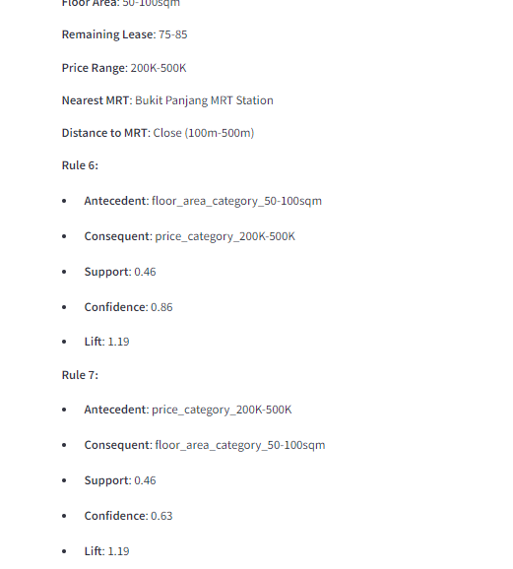
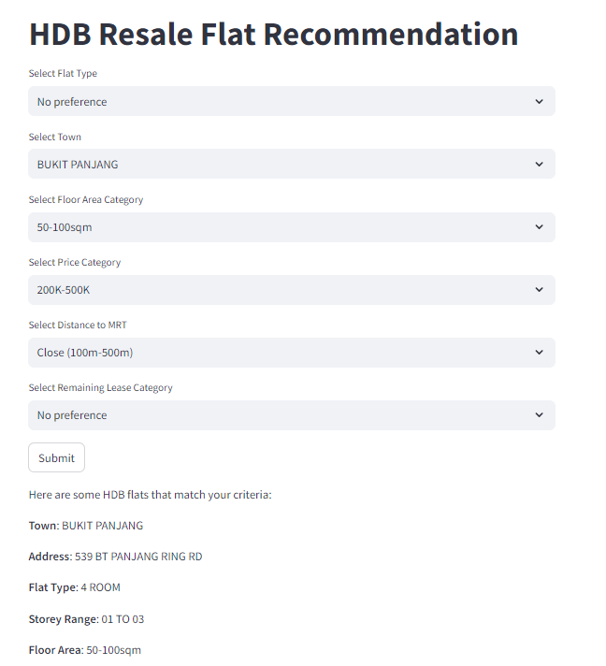
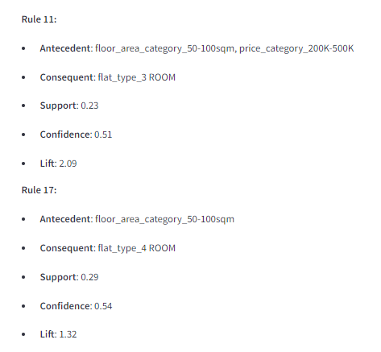
Evaluations & Recommendations
This is the packaged output in streamlit where user has the ability to select fields like flat type nearest to mrt station, preferred town.
And the Association algorithm will find the most frequent data in accordance to the support. This allows the model to recommend user based on their requirements they selected
Business issues that should have address earlier was the selection of the model as I wasted time using the collaborative filtering and generated user_profile which makes the simulation of the data improper.
Recommendations that I would improve is to have a better UI for the streamlit application

Slide 12
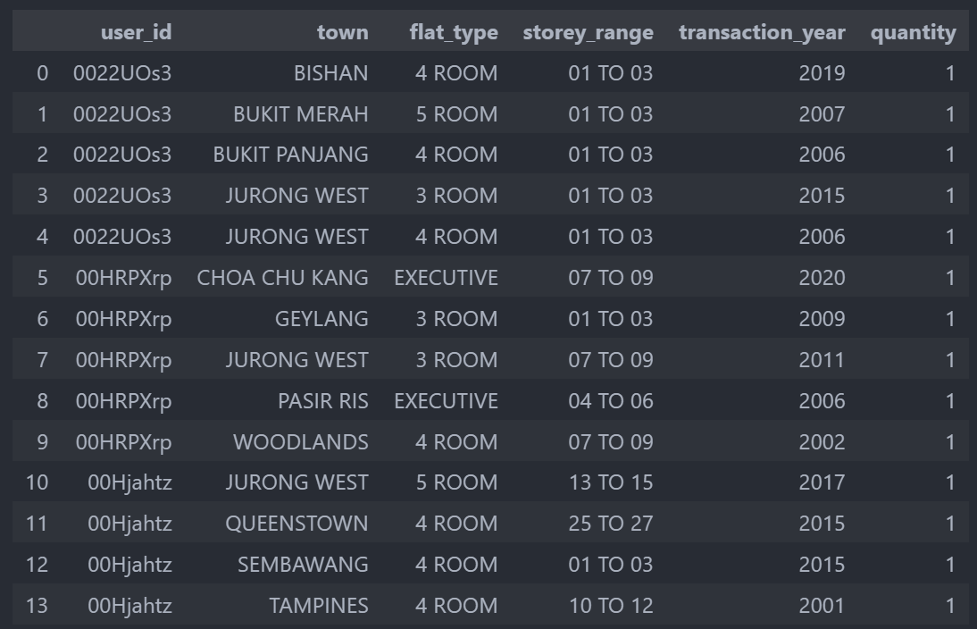
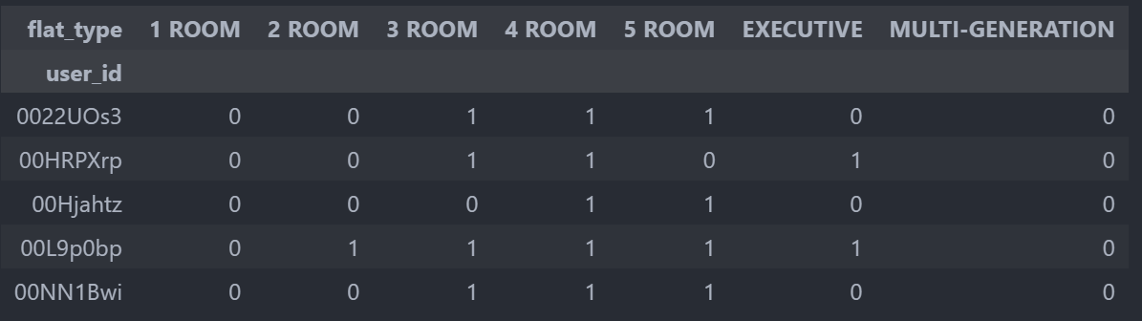
Data Transformation pt 2 - Hassan:
Generated user_id that represents the user that purchased the hdb
For recommendation model for either collaborative and content, I believe the user is required so that in the model it can be infer of similar users that may share the same interest.
Generated user_id
Grouping by user_id
Create a grouping to count number of user_id per each transaction
Group each transaction by the user_id to see the quantity of each transaction
Create user_id matrix
Create a matrix based on the user_id to the flat_type
Using user_id to flat_type matrix, and convert the nan to zero values

Slide 13
Data Transformation - Fariz :
Handle Missing Values Drop ‘remaining_lease’ column because of missing values. Replace 'MULTI GENERATION' with 'MULTI-GENERATION' in the 'flat_type' column
Feature Engineering Extract additional features such as the year from the 'month' column. Add new column ‘year’
Create Target Variable Define price ranges low, medium, high. Add new column to represent these price
Normalize Data Standardize numerical features for 'town', 'flat_type', 'floor_area_sqm', 'lease_commence_date', 'year' and 'month_num' column. Making them suitable for use in Random Forest Classifier
Model Evaluation Use ‘train_test_split’ function to divide the data into training and testing data. A Random Forest Classifier is trained on the training data. The model is evaluated on the testing data set using ‘classification_report’ and ‘accuracy_score’

Slide 14
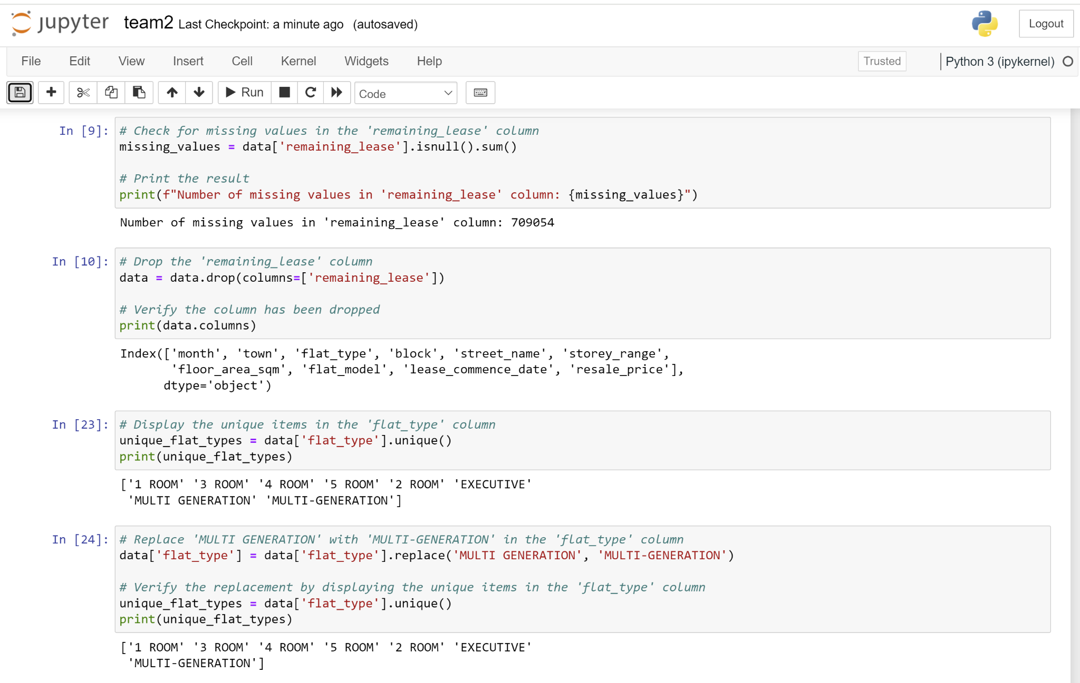
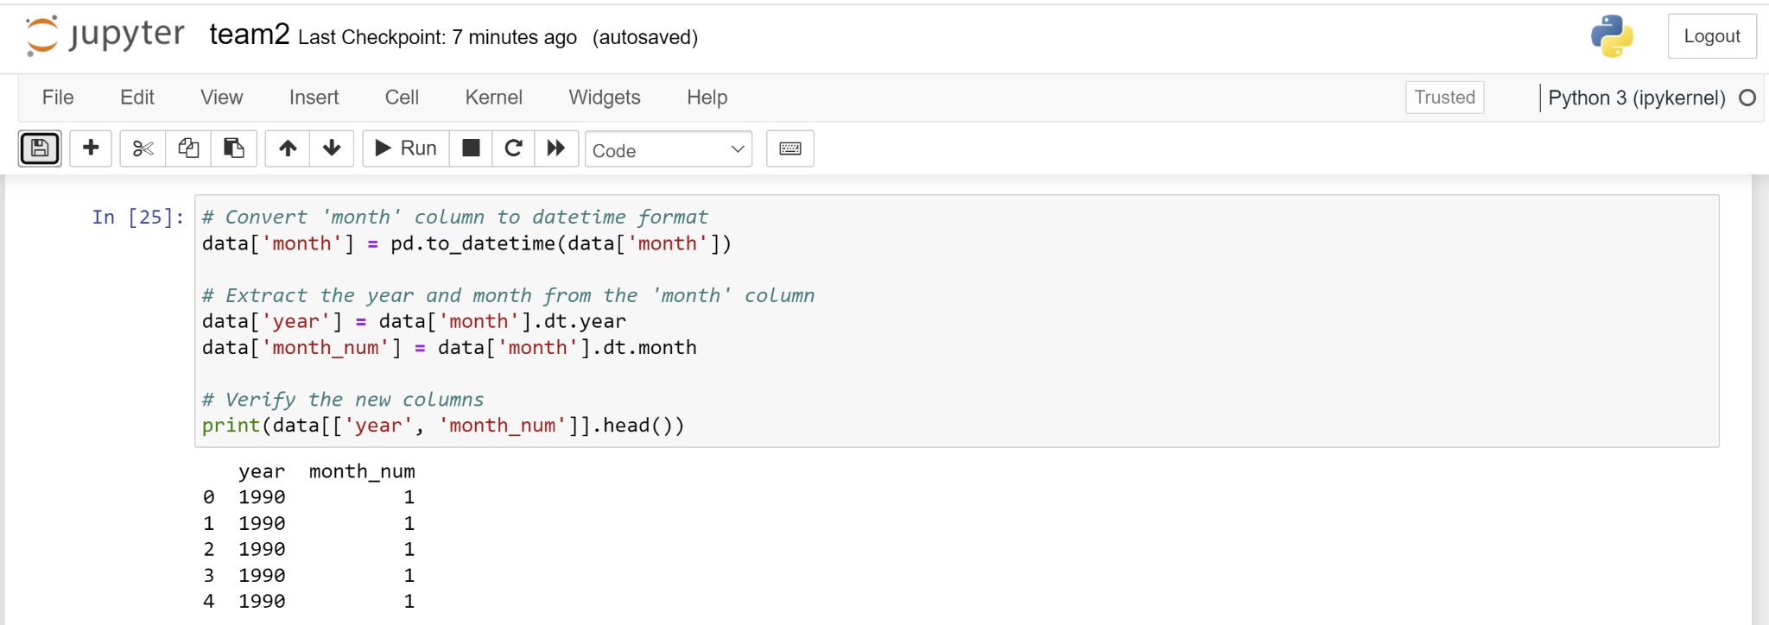
Handle Missing Values by Fariz
Feature Engineering Split year/month

Slide 15
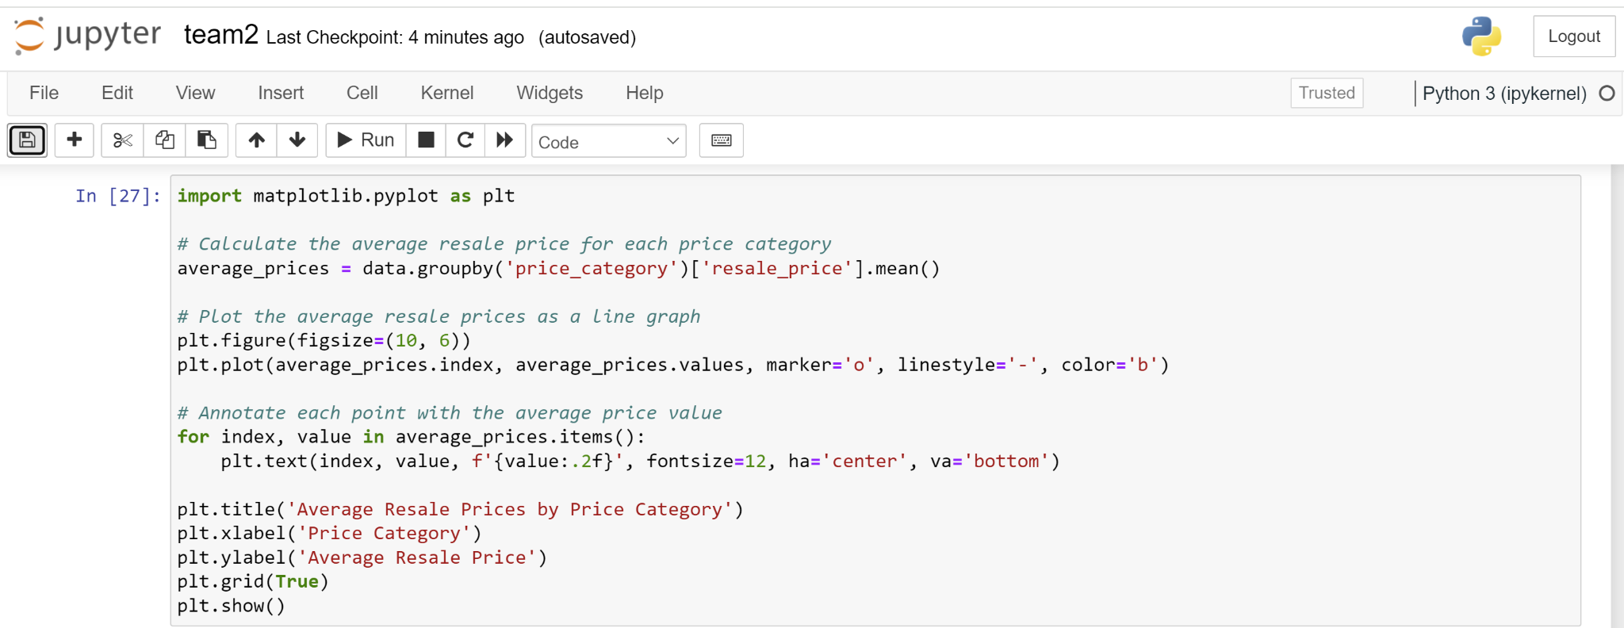
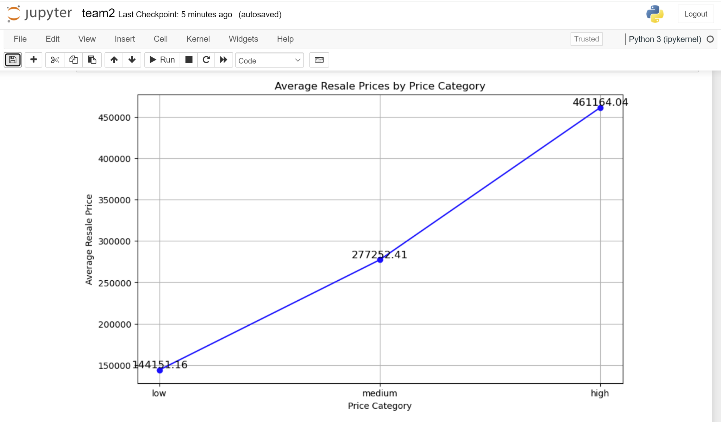
Create Target Variable low/mid/high by Fariz

Slide 16
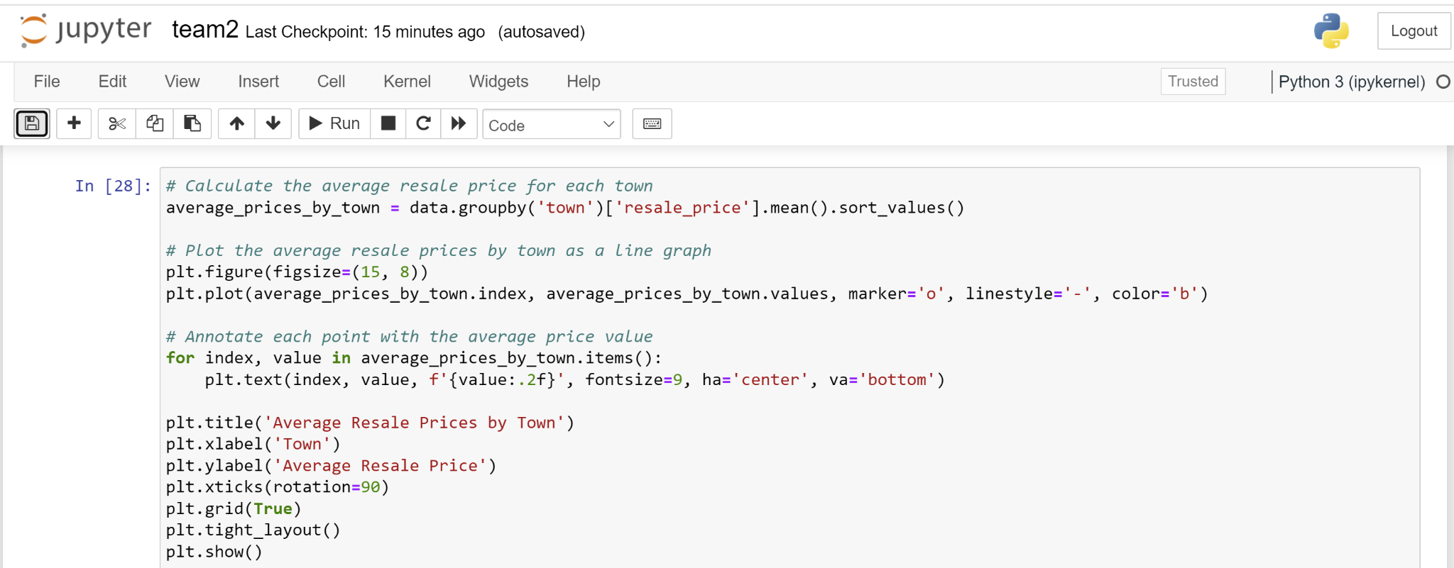
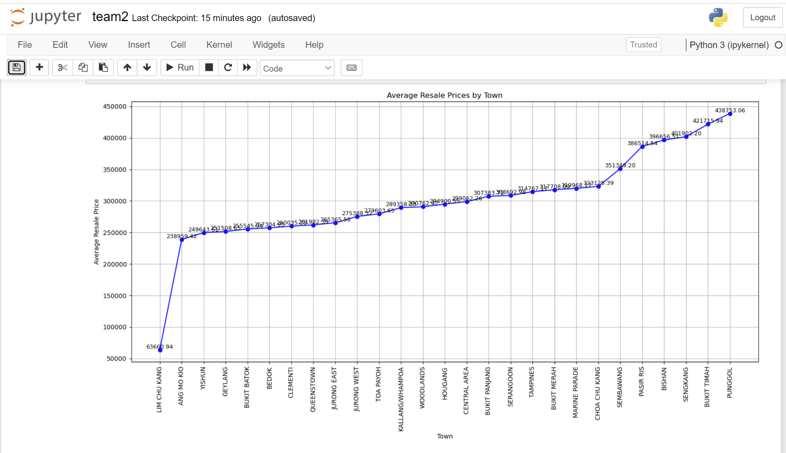
Average Resale Price Town by Fariz

Slide 17
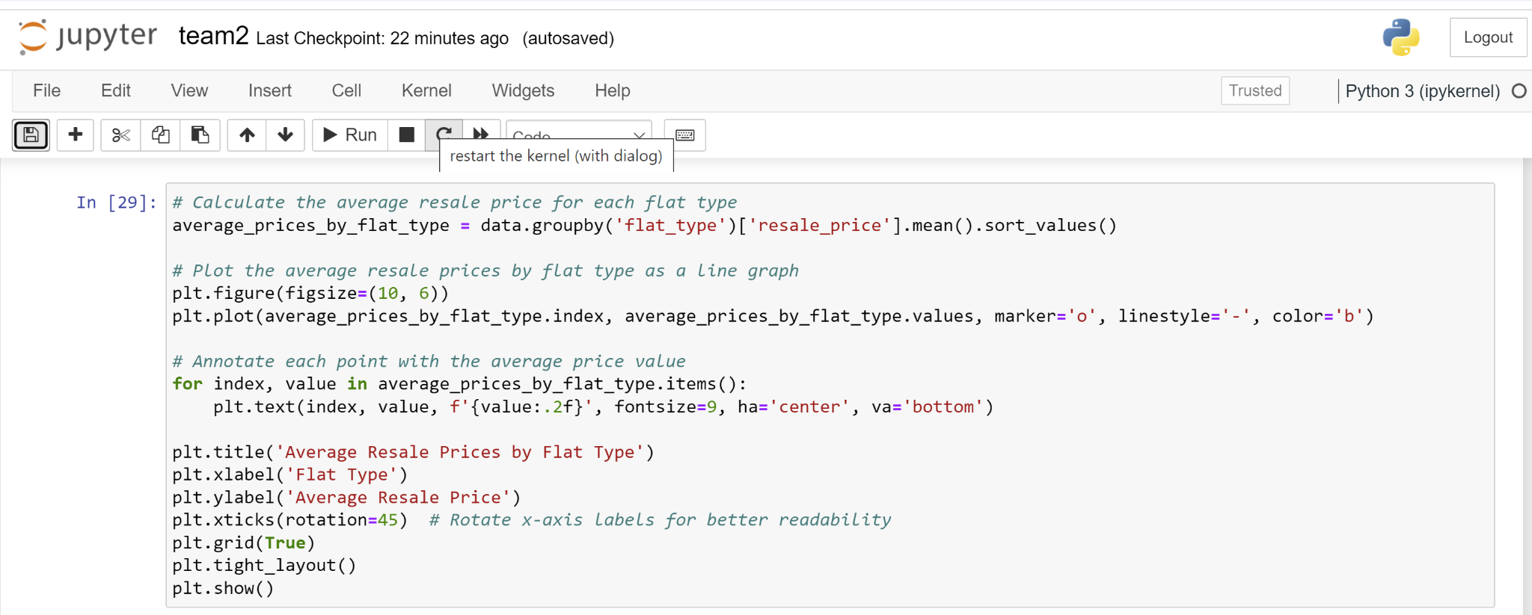
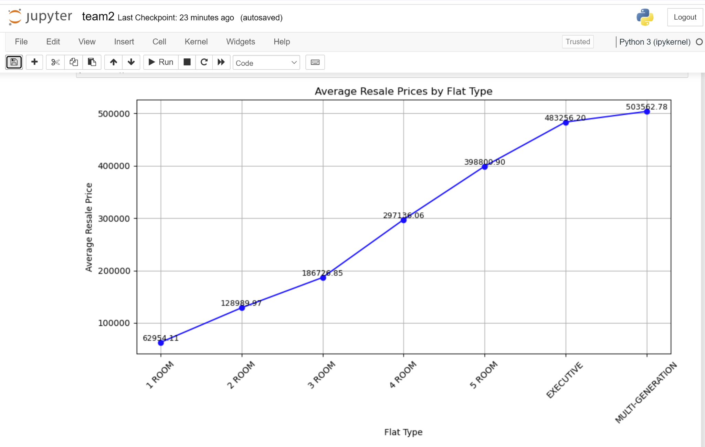
Average Resale Price HDB Flat Type by Fariz

Slide 18
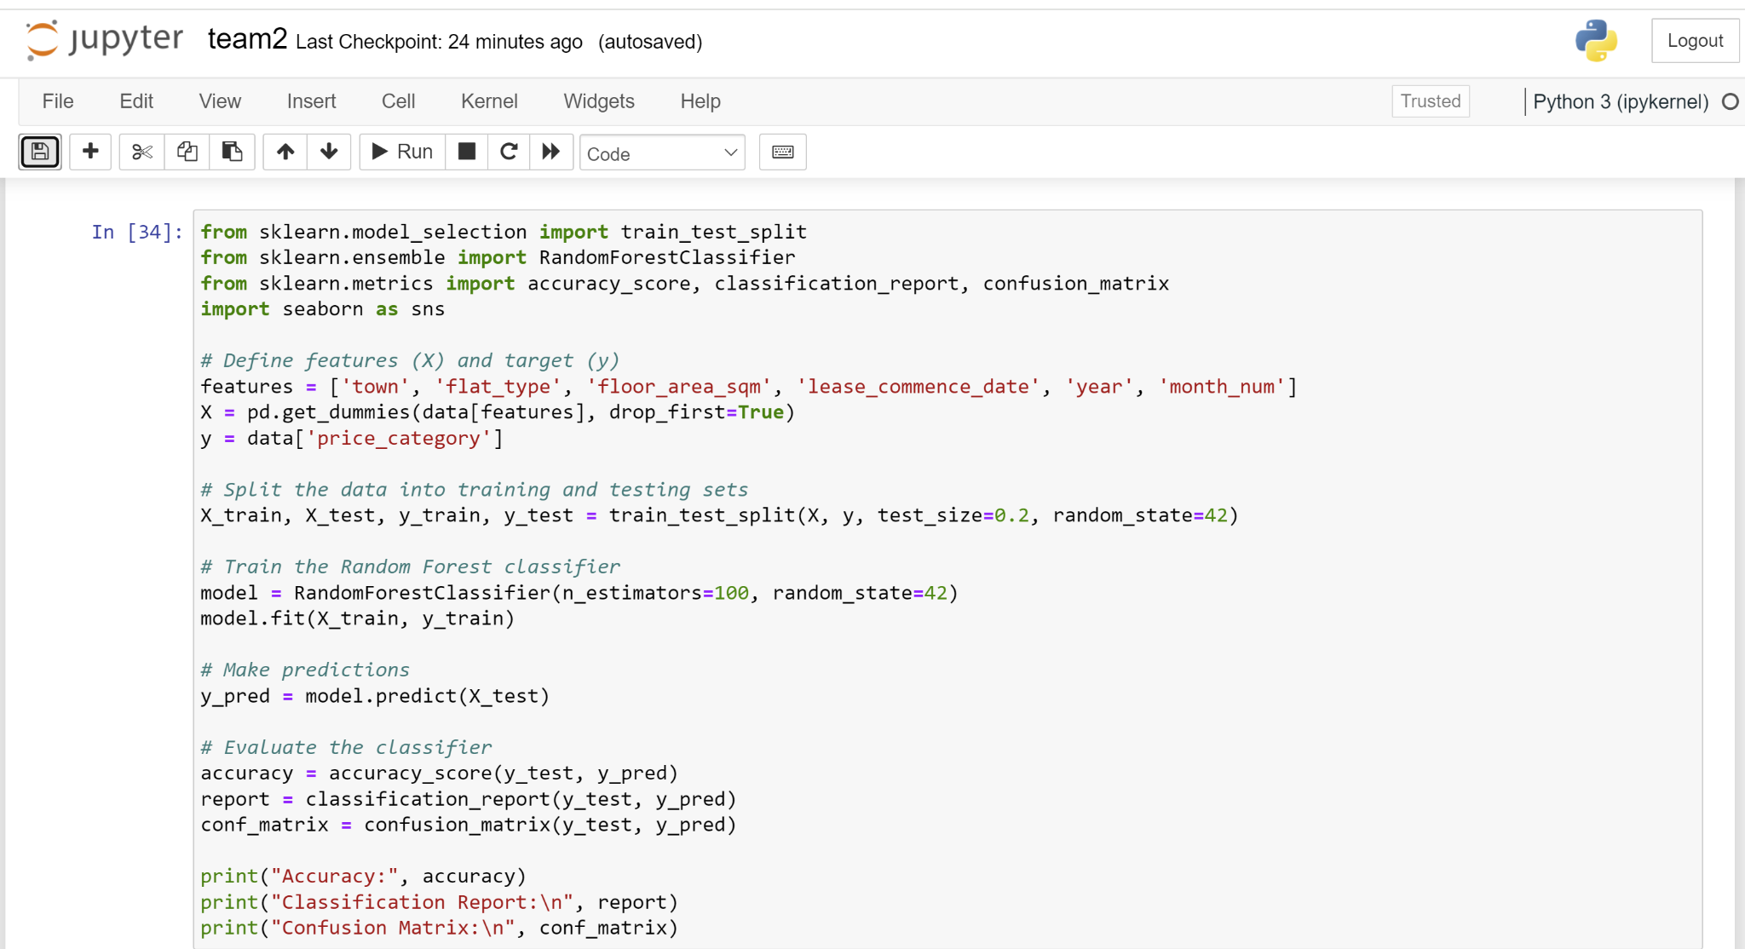
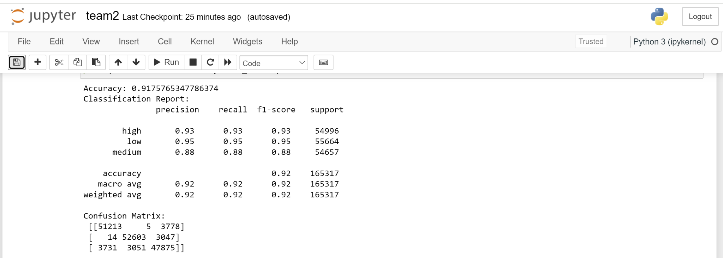
Normalize Data by Fariz
Model Evaluation

Slide 19
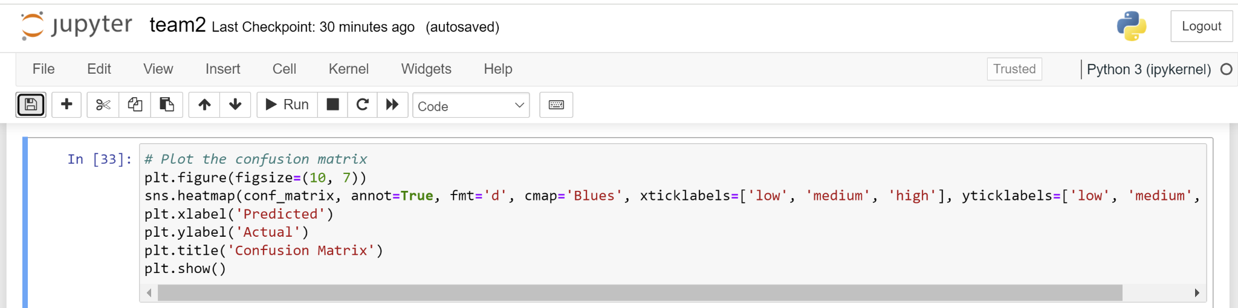
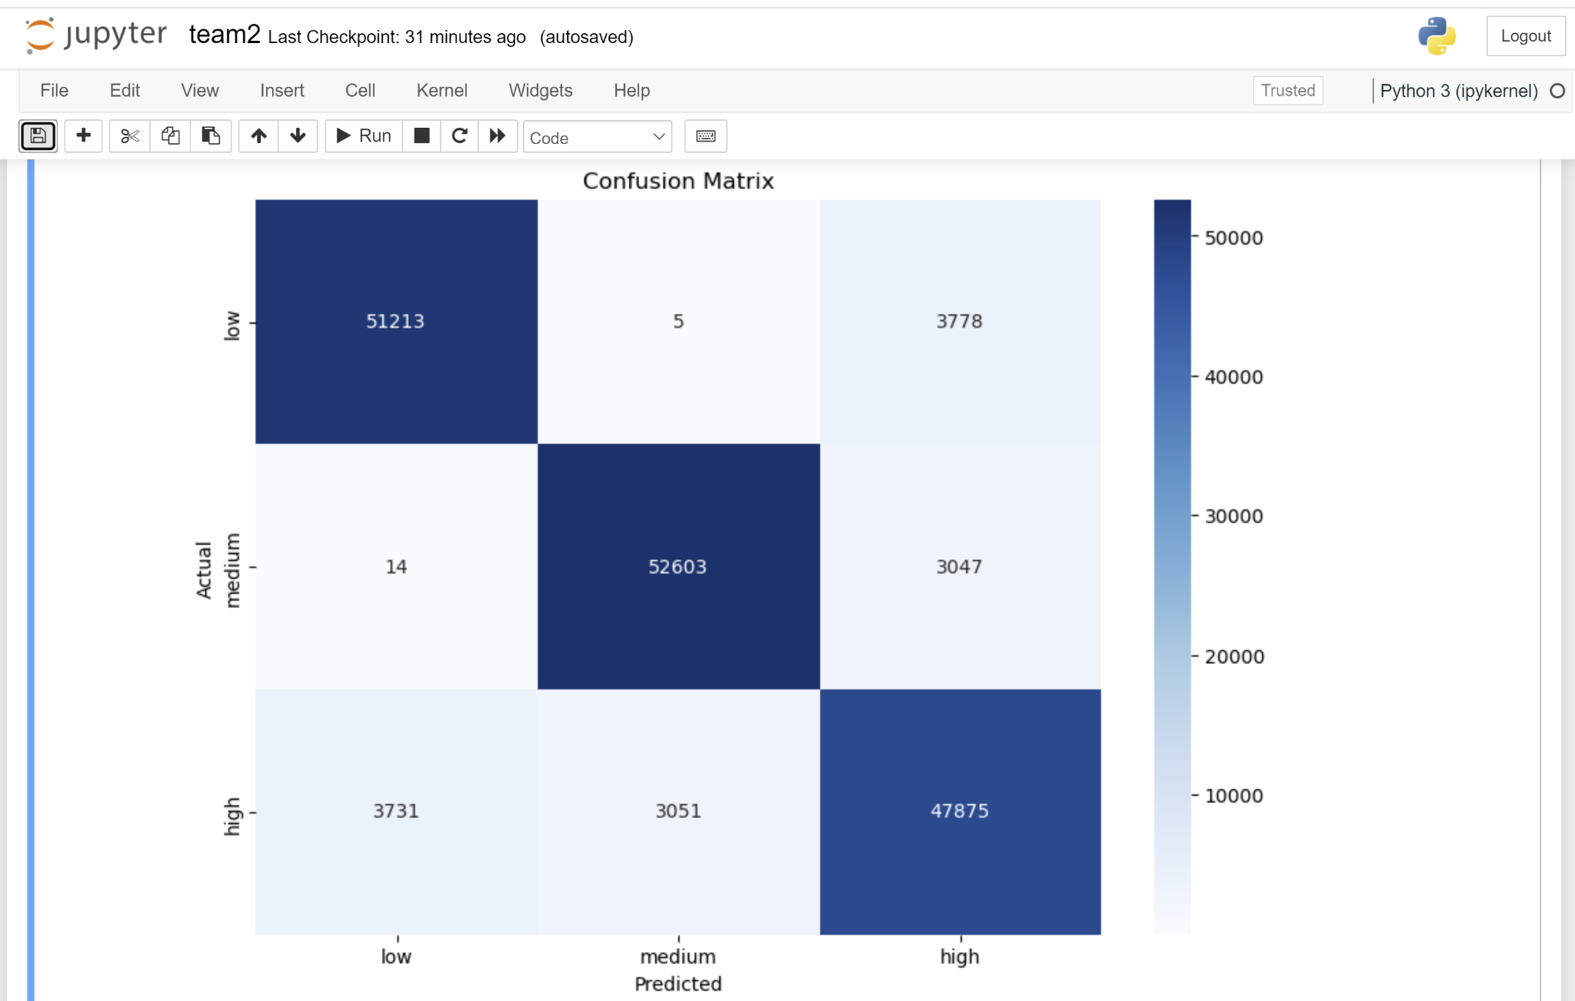
Model Evaluation by Fariz

Slide 20
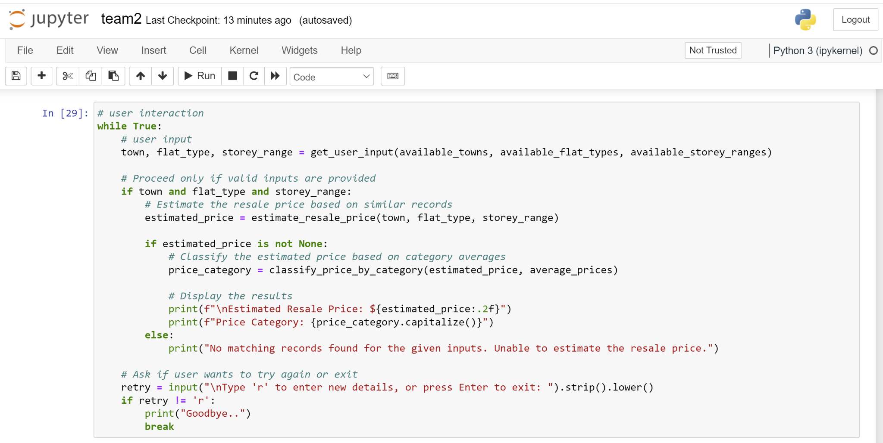
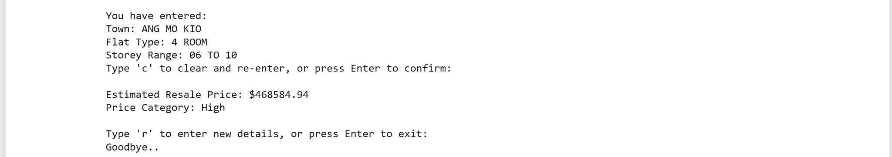
User Interaction by Fariz
Example of User Interaction

Slide 21
Recommendations for Married Couples by Fariz
Assess Affordability:
Use the model to determine if a flat falls into low, medium, or high price categories based on your budget.
Focus on flats categorized as low or medium if you aim to stay within a budget friendly range.
Consider Location:
Review the average resale prices in different towns to find affordable areas.
Consider towns with lower average prices if affordability is a priority.
Flat Type Analysis:
Evaluate different flat types 1-room or 2-room to see which fits your needs and budget.
Smaller flats like 2-room often fall into lower price categories.

Slide 22
Data Transformation - Jia Ying:
Extract 'Year' and 'Month Number' from the 'month' Column
Separate the month column into two distinct columns: year and month_number. This process involves dividing the existing month column, which is formatted as "YYYY-MM", into individual columns for the year and the month
Convert 'Year' and 'Month Number' Columns to Integer Data Types
Convert the year and month_number columns to integer data types. This step is essential for accurate numerical analysis and operations:
Standardize 'Flat Type' Values to Uppercase
Ensure all entries in the Flat Type column are converted to uppercase. This normalization helps maintain consistency and prevents issues related to case sensitivity in text data.
Generating 'ds' Column: Converts 'Year' and 'Month Number' into a single datetime column
Verifying the Data: Ensures the transformation is correct
Model Initialization and Training: Uses the transformed data to train the forecasting model
Notes:
P

Slide 23
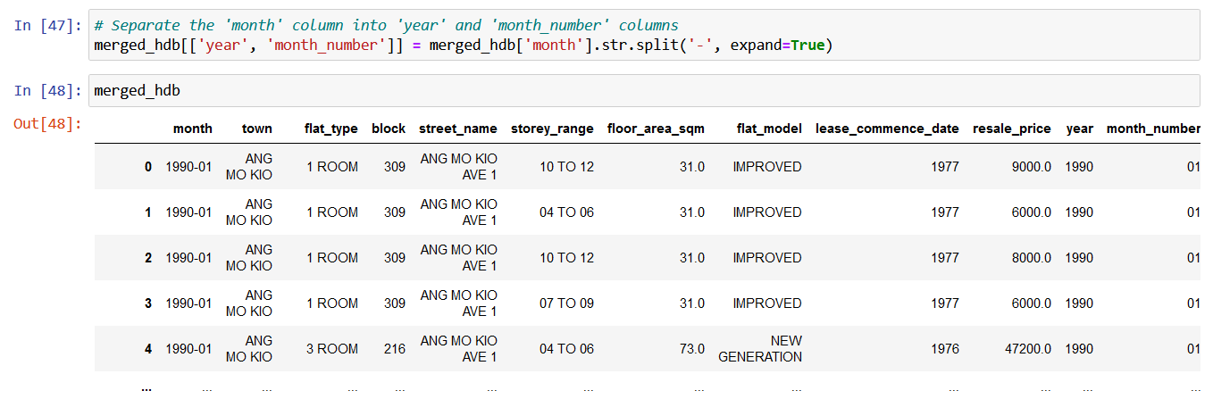
Data Transformation - Jia Ying:
Extract 'Year' and 'Month Number' from the 'month' Column
Separate the month column into two distinct columns: year and month_number. This process involves dividing the existing month column, which is formatted as "YYYY-MM", into individual columns for the year and the month
Notes:
P

Slide 24
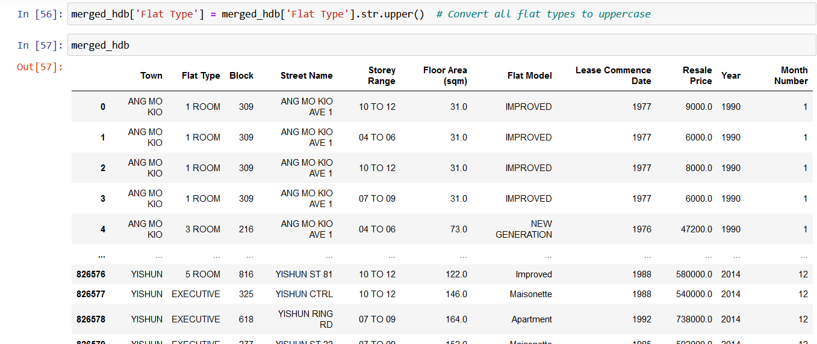
Data Transformation - Jia Ying:
Standardize 'Flat Type' Values to Uppercase
Ensure all entries in the Flat Type column are converted to uppercase. This normalization helps maintain consistency and prevents issues related to case sensitivity in text data.
Notes:
P

Slide 25
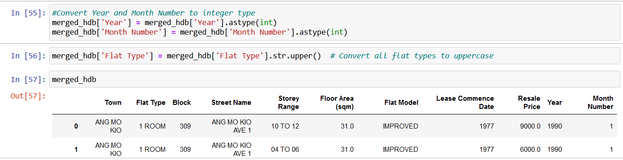
Data Transformation - Jia Ying:
Convert 'Year' and 'Month Number' Columns to Integer Data Types
Convert the year and month_number columns to integer data types. This step is essential for accurate numerical analysis and operations:
Notes:
P

Slide 26
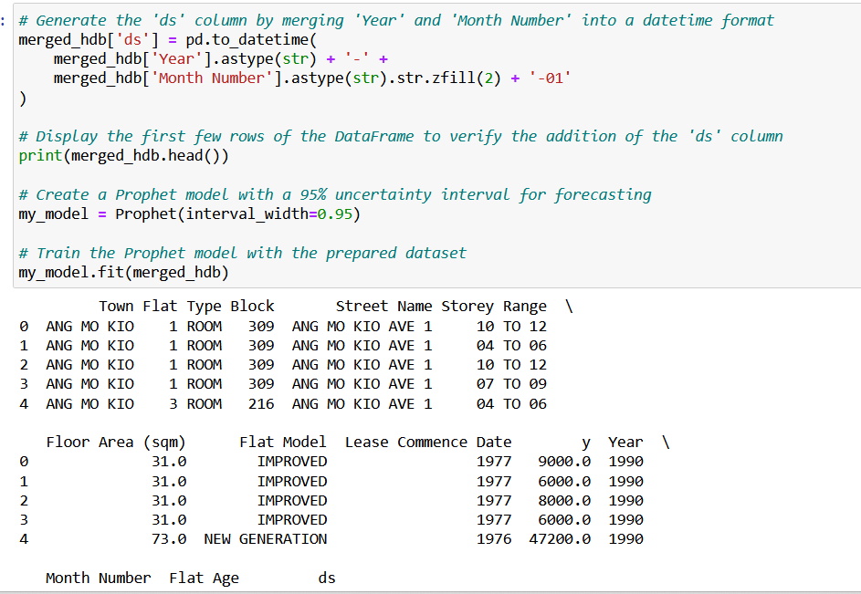
Data Transformation - Jia Ying:
Generating 'ds' Column: Converts 'Year' and 'Month Number' into a single datetime column
Verifying the Data: Ensures the transformation is correct
Model Initialization and Training: Uses the transformed data to train the forecasting model
Notes:
P

Slide 27
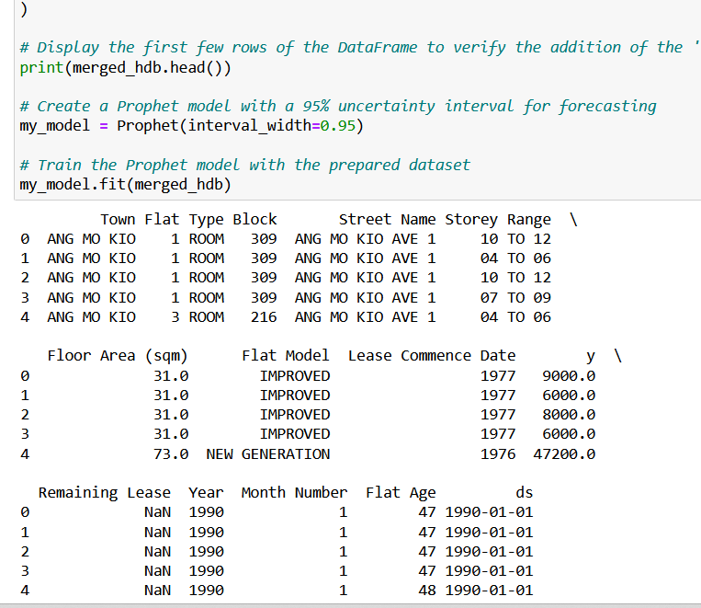
Training the Model with Prophet
A 95% interval provides a good balance between precision and reliability. It is wide enough to account for the variability and uncertainty inherent in statistical predictions, yet not so wide that it becomes uninformative.
Notes:
P

Slide 28
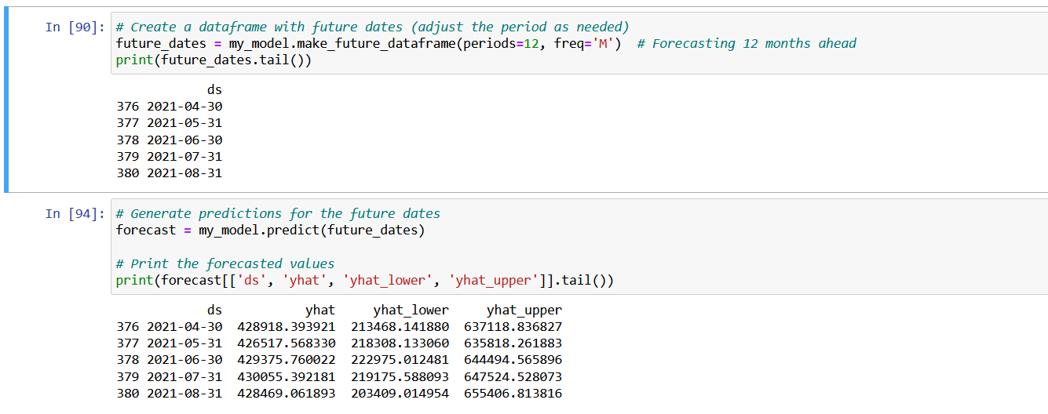
Data Prediction For Next 12 Months
The forecasted values for the future dates provide several insights:
Predicted Values (yhat):
April 2021: 428,918.39
May 2021: 426,517.57
June 2021: 429,375.76
July 2021: 430,055.39
August 2021: 428,469.06
The yhat values represent the model's prediction of the target variable for each future date. The predictions are relatively stable over the months, showing minor fluctuations but no dramatic changes.
Notes:
P

Slide 29
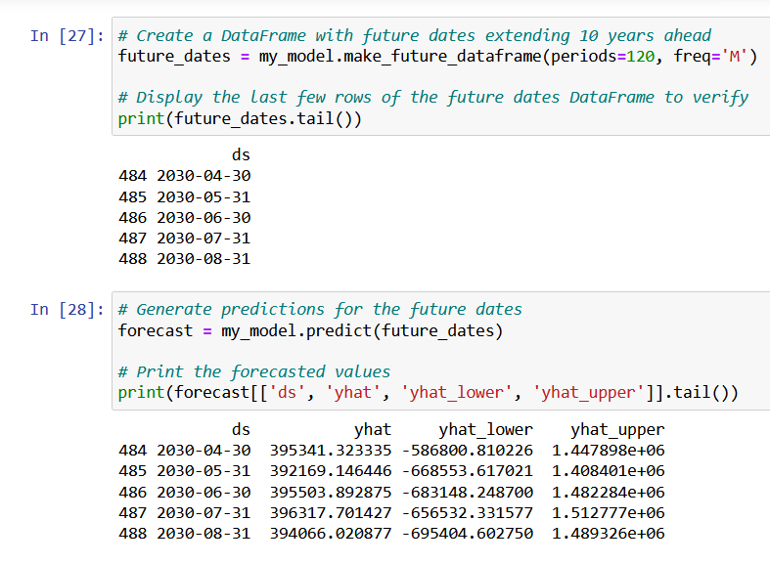
The predicted values (yhat) for the next 10 years show a relatively stable trend with only minor fluctuations. This stability implies that, based on the historical data and the model used, the forecasted values do not exhibit significant growth or decline over the months. For instance:
April 2030: 395,341.32
May 2030: 392,169.15
June 2030: 395,503.89
July 2030: 396,317.70
August 2030: 394,066.02
These values are close to each other, indicating that the model predicts a stable trend with minor variations. This might suggest that, according to the model, the underlying process governing the data remains relatively unchanged in the short term. Such stability can be useful for planning and forecasting if the trend continues as expected.
Data Prediction Until 2030
Notes:
P

Slide 30
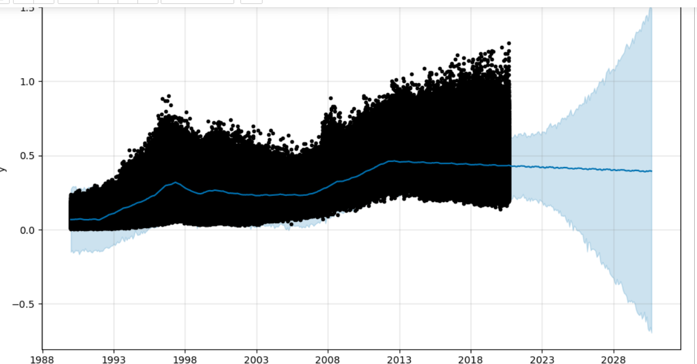
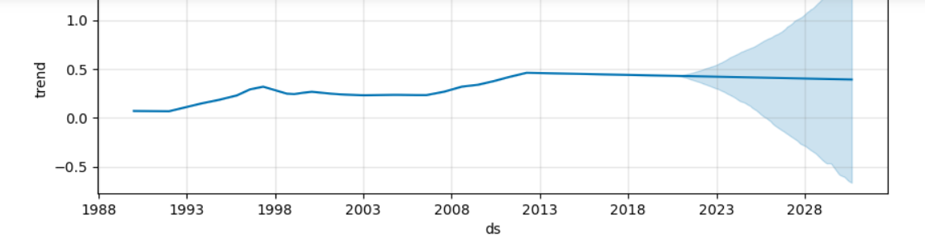
Data Prediction Until 2030
Trend Analysis
Stable Trend with Upward Incline: The forecasted data displays a generally stable trend with a subtle upward slope. This indicates that while the data's overall level remains consistent, there is a gradual increase over time. This kind of trend suggests that there might be underlying factors contributing to a slow but steady growth in the observed variable.
Notes:
P

Slide 31
Data Prediction Until 2030
Implications of a Stable Trend
A stable trend with minor upward movement suggests that the forecast is relatively predictable over the short to medium term. This stability can be advantageous for planning and decision-making, as it provides a consistent expectation of future values with only a gradual increase.
The gentle upward incline signifies that it is experiencing modest growth. This could be due to seasonal factors, gradual improvements, or long-term positive shifts in the underlying process.
The slight upward trend might be driven by external factors such as market conditions, economic growth, or changes in consumer behavior. Identifying these factors can help in understanding the reasons behind the gradual increase.
Notes:
P

Slide 32
Overall Analysis
Strategic Implications for Married Couples
Investment Timing
The stable trend with a slight upward incline provides a general indication that property values are expected to increase modestly. Couples should consider investing sooner rather than later to take advantage of the anticipated price increases.
Budget Planning
Knowing the forecasted price trends and the uncertainty ranges helps in setting realistic budgets for property purchases. Couples can prepare for a range of possible outcomes, ensuring they are financially prepared for various scenarios.
Risk Management
The wide uncertainty intervals highlight the need for cautious planning. Couples should account for potential variations in prices and develop contingency plans. Scenario analysis based on different growth rates or market conditions can help in understanding the potential impacts on their investments.
Long-Term Strategy
The forecast helps in planning long-term property investments and strategic decisions. Couples can use the insights to align their property investment plans with the expected market trends, whether it involves purchasing, upgrading, or diversifying their property portfolio.
Notes:
P

Slide 33
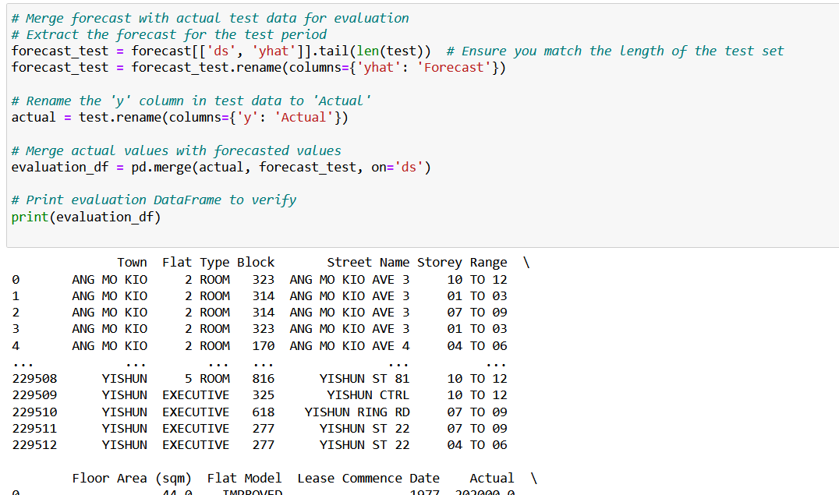
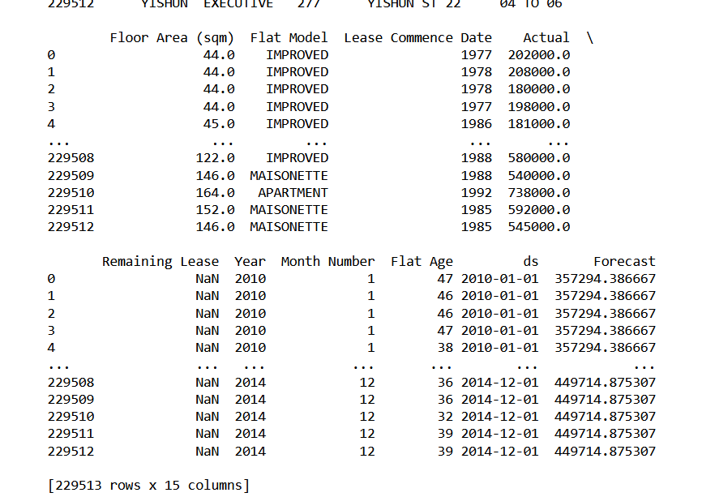
Model Evaluation
Notes:
P

Slide 34
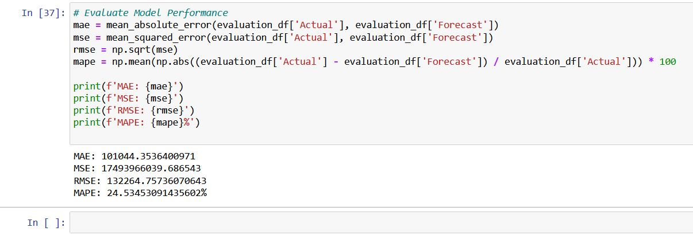
Model Evaluation
Notes:
P

Slide 35
Data Transformation - WeeKiat:
Text Analytic to determine if the reviews made is a positive or negative experience.
Review from various type of Housing in Singapore
HDB
Condo
Private Estate
Overseas placement

Slide 36
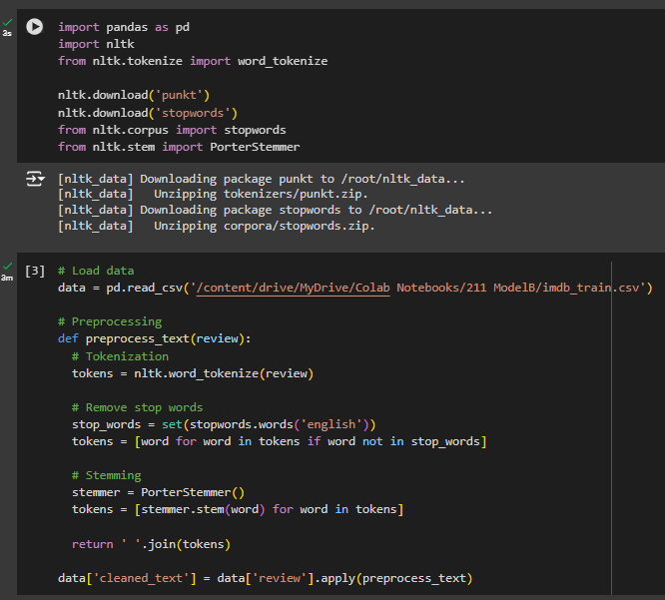
Data Transformation - Predict User Review:
1. Data Collection
Identify your data sources: This could be product reviews, social media comments, survey responses, news articles, or any text data relevant to your analysis.
2. Clean and preprocess the data:
Tokenization: breaks down the review text into individual words (tokens) using NLTK's word tokenizer.
Stop Word Removal: create a set of English stop words and then filter out these words from the list of tokens.
Stemming: reducing words to their root form (e.g., "running" -> "run").

Slide 37
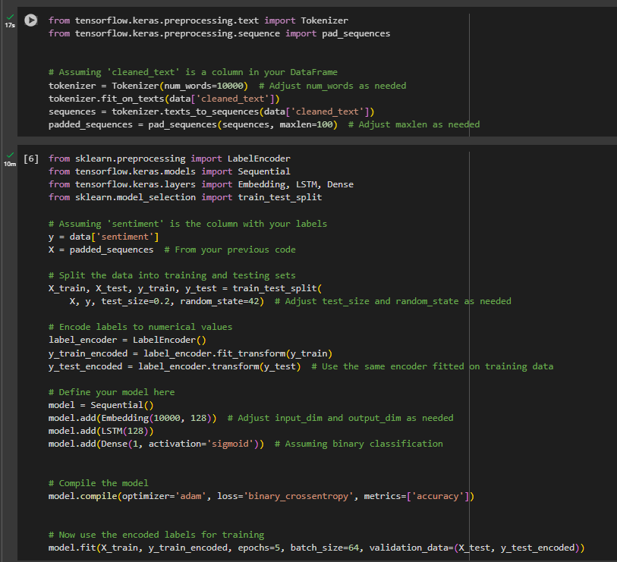
Data Transformation - Predict User Review:
3. Prepares your text data for use in a neural network by tokenizing it, building a vocabulary, converting text to numerical sequences, and padding the sequences to a uniform length.
4. Sets up the foundation for building a sentiment analysis model by extracting labels and features, and preparing to split the data for training and evaluation.
y = data['sentiment']: Extracts the sentiment labels (the target variable) from your DataFrame and stores them in y.
Split the data into training and testing sets
Training Set: Used to train your model.
Testing Set: Used to evaluate the performance of your trained model on unseen data.
Notes:
These metrics are crucial in evaluating the performance of a classification model, particularly in imbalanced datasets.
Precision: Measures how accurate your positive predictions are. In simpler terms, it's the proportion of positive predictions that were actually correct.
Formula: Precision = True Positives / (True Positives + False Positives)
Recall: Measures how well your model can find all the positive cases. It's the proportion of actual positives that were correctly identified.
Formula: Recall = True Positives / (True Positives + False Negatives)
F1-Score: A harmonic mean of precision and recall, providing a balance between the two. It's useful when you need to consider both precision and recall equally.
Formula: F1-Score = 2 * (Precision * Recall) / (Precision + Recall)
Support
Support: Represents the number of actual occurrences of the class in the dataset. It's essential to consider when evaluating model performance, as imbalanced datasets can affect these metrics.

Slide 38
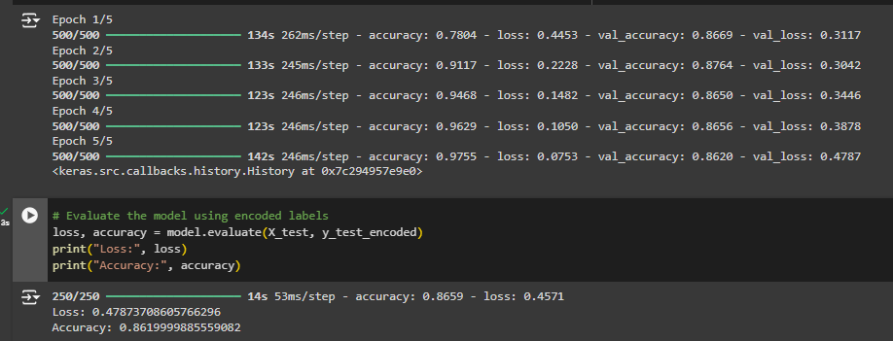
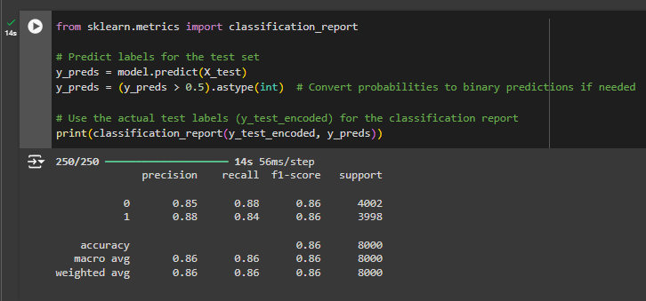
Data Transformation - Predict User Review:
5. Evaluates your trained sentiment analysis model on dataset and provides you with metrics (loss and accuracy) to gauge its performance. These metrics help you understand how well your model generalizes to new data and whether it needs further improvement.
6. Generates a comprehensive report that helps you analyze the performance of your sentiment analysis model. it provides insights into how well the model handles different classes and can help you identify areas for improvement.
Precision: The proportion of correctly predicted positive instances out of all instances predicted as positive.
Recall: The proportion of correctly predicted positive instances out of all actual positive instances.
F1-score: A harmonic mean of precision and recall, providing a balanced measure of performance.
Support: The number of instances in each class.
Notes:
These metrics are crucial in evaluating the performance of a classification model, particularly in imbalanced datasets.
Precision: Measures how accurate your positive predictions are. In simpler terms, it's the proportion of positive predictions that were actually correct.
Formula: Precision = True Positives / (True Positives + False Positives)
Recall: Measures how well your model can find all the positive cases. It's the proportion of actual positives that were correctly identified.
Formula: Recall = True Positives / (True Positives + False Negatives)
F1-Score: A harmonic mean of precision and recall, providing a balance between the two. It's useful when you need to consider both precision and recall equally.
Formula: F1-Score = 2 * (Precision * Recall) / (Precision + Recall)
Support
Support: Represents the number of actual occurrences of the class in the dataset. It's essential to consider when evaluating model performance, as imbalanced datasets can affect these metrics.

Slide 39
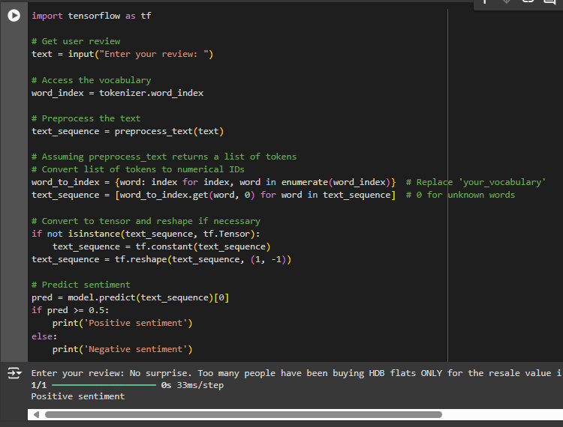
Data Transformation - Predict User Review:
7. Prompts the user to enter a review to predict the sentiment.
Access Vocabulary maps words to their numerical indices.
Preprocess Text involves tokenization, stop word removal, and stemming.
Converts each word to its corresponding numerical index using the word_index dictionary.
Print Numerical Sequence: The resulting list of numerical IDs representing the user's review is printed.
Notes:
These metrics are crucial in evaluating the performance of a classification model, particularly in imbalanced datasets.
Precision: Measures how accurate your positive predictions are. In simpler terms, it's the proportion of positive predictions that were actually correct.
Formula: Precision = True Positives / (True Positives + False Positives)
Recall: Measures how well your model can find all the positive cases. It's the proportion of actual positives that were correctly identified.
Formula: Recall = True Positives / (True Positives + False Negatives)
F1-Score: A harmonic mean of precision and recall, providing a balance between the two. It's useful when you need to consider both precision and recall equally.
Formula: F1-Score = 2 * (Precision * Recall) / (Precision + Recall)
Support
Support: Represents the number of actual occurrences of the class in the dataset. It's essential to consider when evaluating model performance, as imbalanced datasets can affect these metrics.

Slide 40
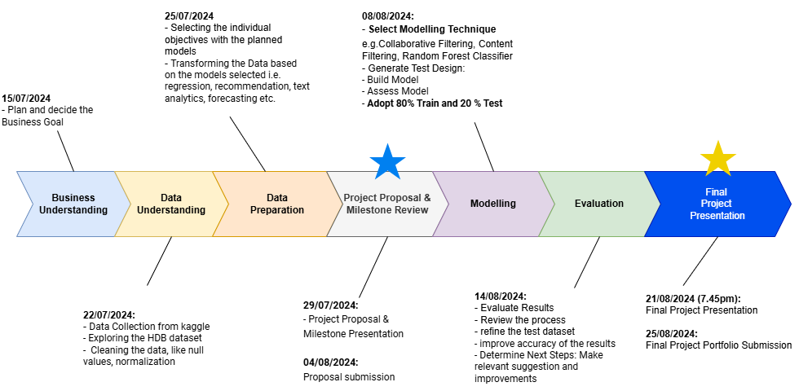
Project Timeline

Slide 41
Conclusion:
Business Goal :
Empowering married couples with predictive insights into HDB resale prices to best prepare them in decision-making and strategic planning.
Overall one of the model that we recommend to users is Association Rule Model (FP-Growth). Combined with the streamlit app as it greatly helps married couples or anyone when purchasing their HDB flats. As now by selecting the fields that are mostly relatable to them helps see the available possible HDB flats they might be interested in.
Possible improvements is to store the saved models, as the Streamlit app is currently interfacing to the live model making it very slow when churning possible recommendations
The other model that we would like to recommend is the Random Forest Classifier, which helps the couples group the HDB resale prices into Low Medium and High groups. Enabling them to have a clearer expectation of the budget handling. This also helps couples to understand whether a flat is a good investment or within their budget.
Also to improve on the text analytics model we can pay attention to features and amenities highlighted as desirable by other buyers through sentiment analysis which can guide final decision for married couples
We can also use the time forecasting model for couples to have an indication whether property values are expected to increase modestly. This will help couples anticipate price changes in the future.

Slide 42
Q & A

Slide 43
Modeling
Split the Data: Divide the data into training and testing sets (e.g., 80/20 split).
Select a Model: Choose appropriate machine learning models based on the problem (e.g., linear regression for continuous output, classification models for categorical output).
For example:
Linear Regression, Decision Trees, Random Forest, Gradient Boosting for regression tasks.
Logistic Regression, Decision Trees, Random Forest, Support Vector Machines for classification tasks.
Train the Model: Fit the model on the training data.
Hyperparameter Tuning: Use techniques like grid search or random search to find the best parameters for the model.
3. Evaluation
Evaluate on Training Data: Check for underfitting or overfitting using metrics such as R^2, MAE, RMSE for regression or accuracy, precision, recall, F1-score for classification.
Evaluate on Testing Data: Assess model performance on unseen data using the same metrics.
Cross-Validation: Use k-fold cross-validation to ensure the model's performance is robust across different subsets of the data.
4. Model Interpretation
Feature Importance: Identify which features have the most impact on predictions.
Model Explainability: Use techniques like SHAP values, LIME, or partial dependence plots to explain individual predictions.
5. Model Deployment
Save the Model: Serialize the trained model using tools like joblib or pickle.
Deploy: Integrate the model into a production environment (e.g., web service, batch processing pipeline).
Monitor: Continuously monitor model performance in production and retrain as necessary.
Modelling and Evaluation:
Share what is the next steps, after cleaning what are the next steps
After data transformation and grouping the data from 1990-2020, we will be moving to focus on to each of us doing the modelling.
Forecasting: Jia ying
Regression: Fariz
Recommendation: Hassan
Text Analysis: Wee Kiat
Training the model based on the different objectives specified, and enhance the model accordingly by tweaking the hyperparameters.
Check for underfitting or overfitting using metrics such as F1-score for classification, RMSE for regression, etc.
Then assess the model performance on the test data set, on 80:20.

Slide 44
Objective 1: Forecasting Model - Jiaying:
Objective: Develop a time-series forecasting model to predict future HDB resale prices based on historical data from 1990 to 2000.
Goal: Enable accurate prediction of future resale prices, allowing stakeholders to anticipate market trends and make informed investment and policy decisions.
KPI: Achieve high predictive accuracy with a margin of error within ±5% of actual future prices.
Objective 2: Clustering Model:
Objective: Use clustering algorithms to segment HDB flats into distinct groups based on similarities in attributes like location, age, size, and price trends.
Goal: Identify different market segments and their unique characteristics to tailor marketing strategies and policy interventions.
KPI: Create clusters with clear, distinguishable characteristics and ensure meaningful segment differentiation.
Objective 3: Sentiment Analysis Model:
Objective: Implement a sentiment analysis model to assess public sentiment and opinions about the HDB resale market using historical news articles, forum discussions, and social media posts from 1990 to 2000.
Goal: Understand public perception and sentiment towards HDB policies and market conditions to guide future policy-making and market strategies.
KPI: Achieve high sentiment classification accuracy and extract key insights that correlate sentiment trends with market price movements.
Objective 4: Regression Model - Fariz: Objective: Build a regression model to quantify the relationship between HDB resale prices and various influencing factors such as location, size, age, and economic indicators.
Goal: Provide precise estimates of how each factor impacts resale prices to help stakeholders understand price determinants.
KPI: Achieve high model interpretability and statistical significance of key factors, with a high R-squared value indicating good fit.
Objective 5: Classification Model: Objective: Develop a classification model to categorize HDB flats into different price tiers (e.g., low, medium, high) based on their attributes.
Goal: Assist buyers and sellers in quickly identifying the value category of a property, streamlining decision-making.
KPI: Achieve high classification accuracy and balanced precision and recall across all price tiers.
Objective 6: Recommendation System - Hassan: Objective: Create a recommendation system that suggests optimal buying or selling times and the best neighborhoods for investment based on historical price trends and individual preferences.
Goal: Provide personalized recommendations to potential buyers and sellers to maximize investment returns.
KPI: Measure user satisfaction and recommendation relevance, ensuring recommendations align with market movements.
Objective 7: Natural Language Processing (NLP) Model:
Objective: Use an NLP model to analyze textual data such as property descriptions, advertisements, and buyer reviews from the 1990 to 2000 period.
Goal: Extract valuable insights on features and amenities that were most appealing to buyers, informing future property development and marketing strategies.
KPI: Extract key themes and sentiment from textual data with high accuracy, providing actionable insights into buyer preferences.

Slide 45
Data Collection and Exploration:
Utilize historical match data available from Kaggle and Retrosheet to train predictive models.
Data Transformation:
Transform data into suitable formats for machine learning models.
Handle missing values, outliers, and normalize data to improve model performance.
Modelling and Evaluation:
Implement logistic regression models to predict win or lose match outcomes.

Slide 46
https://github.com/changjulian17/resale_HDB/tree/master
Data from https://beta.data.gov.sg/collections/189/view
https://www.kaggle.com/datasets/teyang/singapore-hdb-flat-resale-prices-19902020

